Slide 1

University Institute of Liberal Arts and Humanities
Course Name – Communication Skills
Course Code – 23PCH-105
Memorandum
DISCOVER . LEARN . EMPOWER

Slide 2
COURSE OBJECTIVES
The Course aims to:
1 | Augment students overall communication and interpersonal skills by making them realize the importance of good oral and written English Language in professional life.
2 | Enrich their reading capability with special emphasis on expanding vocabulary and grammatical formations.
3 | Build exceptional speaking, reading and writing skills by correcting grammatical errors and pronunciation through practice.
4 | Enhances soft skills by fostering self awareness, confidence and a positive attitude in students’ ability to communicate effectively in English.

Slide 3
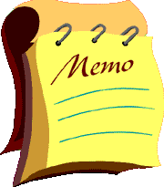
Course Outcomes
On completion, the students are expected to:
CO Number | Title | Level
CO1 | Apply appropriate Listening, Speaking, Reading and Writing Skills (LSRW Skills) with correct non-verbal cues to attain expertise in soft skills. | Apply
CO2 | Apply correct contextual and comprehensible written text in the form of paragraph writing, short compositions business correspondence, using logical support and argument in a wide range of communication situations. | Apply
CO3 | Demonstrate linguistic competence while speaking and during presentations through accuracy in grammatical usage, vocabulary, pronunciation and intonation. | Apply
CO4 | Evaluate information as critical readers, speakers and writers applying ethics in communication and being sensitive in cross cultural communication. | Evaluate
CO5 | Create original, digital content for websites, blogs, vlogs and personal social media profiles etc. | Create
https://in.images.search.yahoo.com/

Slide 4
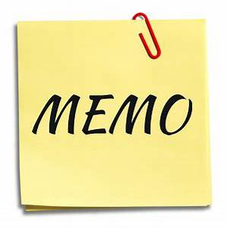
Memorandum
1) Memorandum is popularly known as memo.
2)The literal meaning of the word memorandum is “a note to assist the memory”.
3) Memos are the written internal communication means for exchanging information relating to day-to-day functions within the organizations.
https://in.images.search.yahoo.com/

Slide 5

Memorandum
A memo is less formal than a letter.
It usually conveys one idea and
is likely to be short.
Effective memos are clearly written
with the objective stated in the first
sentence.
https://in.images.search.yahoo.com/

Slide 6
Purposes of Memos
Memos are often only a few short paragraphs, but they can be much longer, depending on their purpose.
Here are some typical uses of memos:
broadcast internal changes
disseminate news
share an upcoming event
update public safety guidelines
raise awareness about an issue
address a problem
make a request
share project updates.

Slide 7
Check Your Memo
Is it easy to find the main point?
Does your memo have plenty of white space for easy readability?
Have you removed unnecessary words?
Is your memo filled with technical jargon?
Is it positive?

Slide 8
Important “Nevers” in Memo Writing
Never write unnecessary information.
Never write complicated, hard-to-understand memos.
Never send memos that have
misspelled words, or grammatical errors
Keep them simple and to the point. Never write rude, blunt, or thoughtless memos.
Never use complimentary close and salutation in the memo
https://in.images.search.yahoo.com_

Slide 9
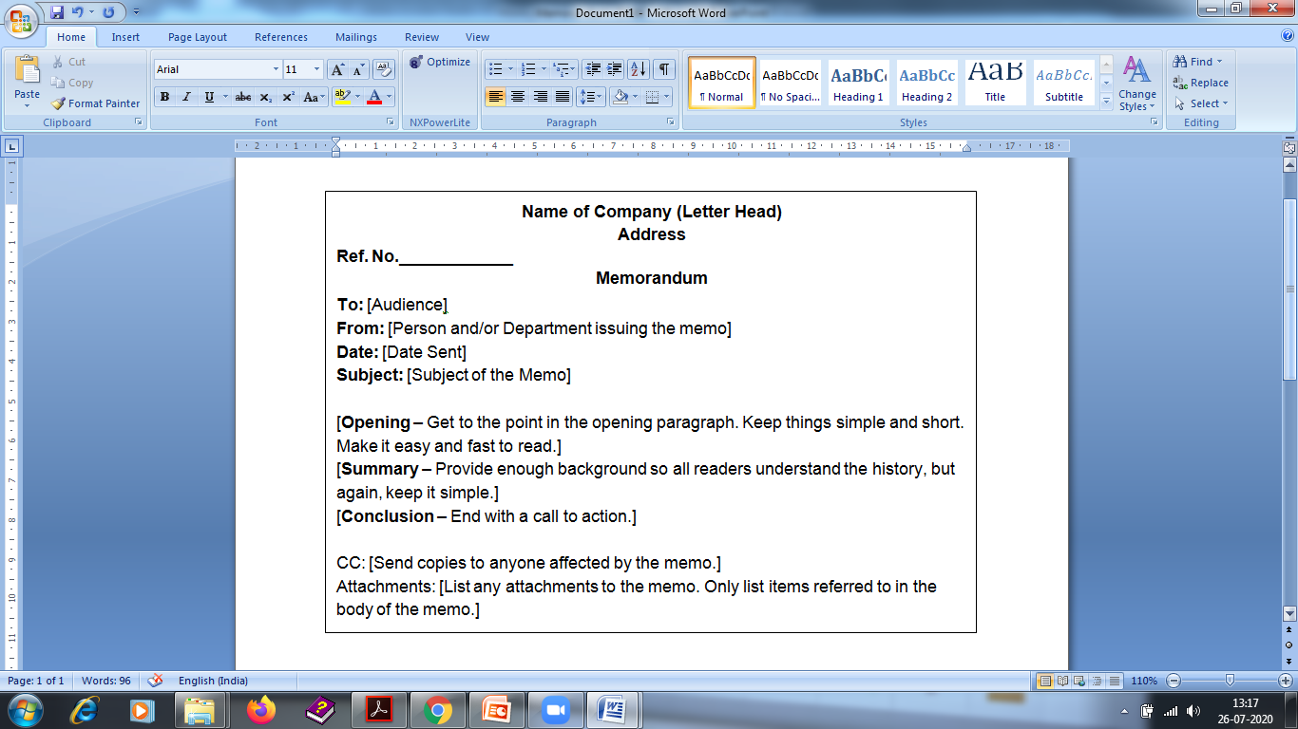
Format

Slide 10
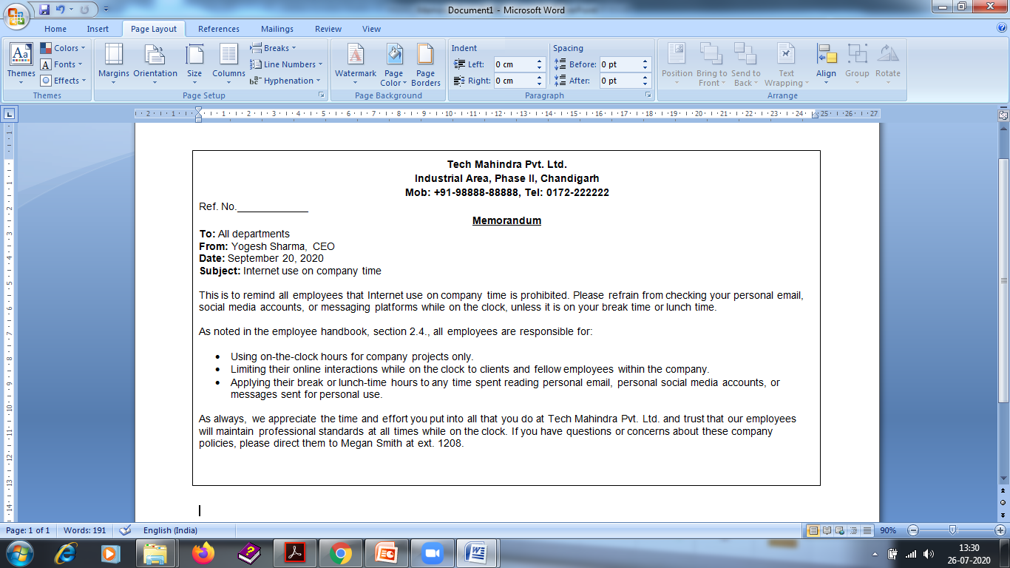
Sample

Slide 11
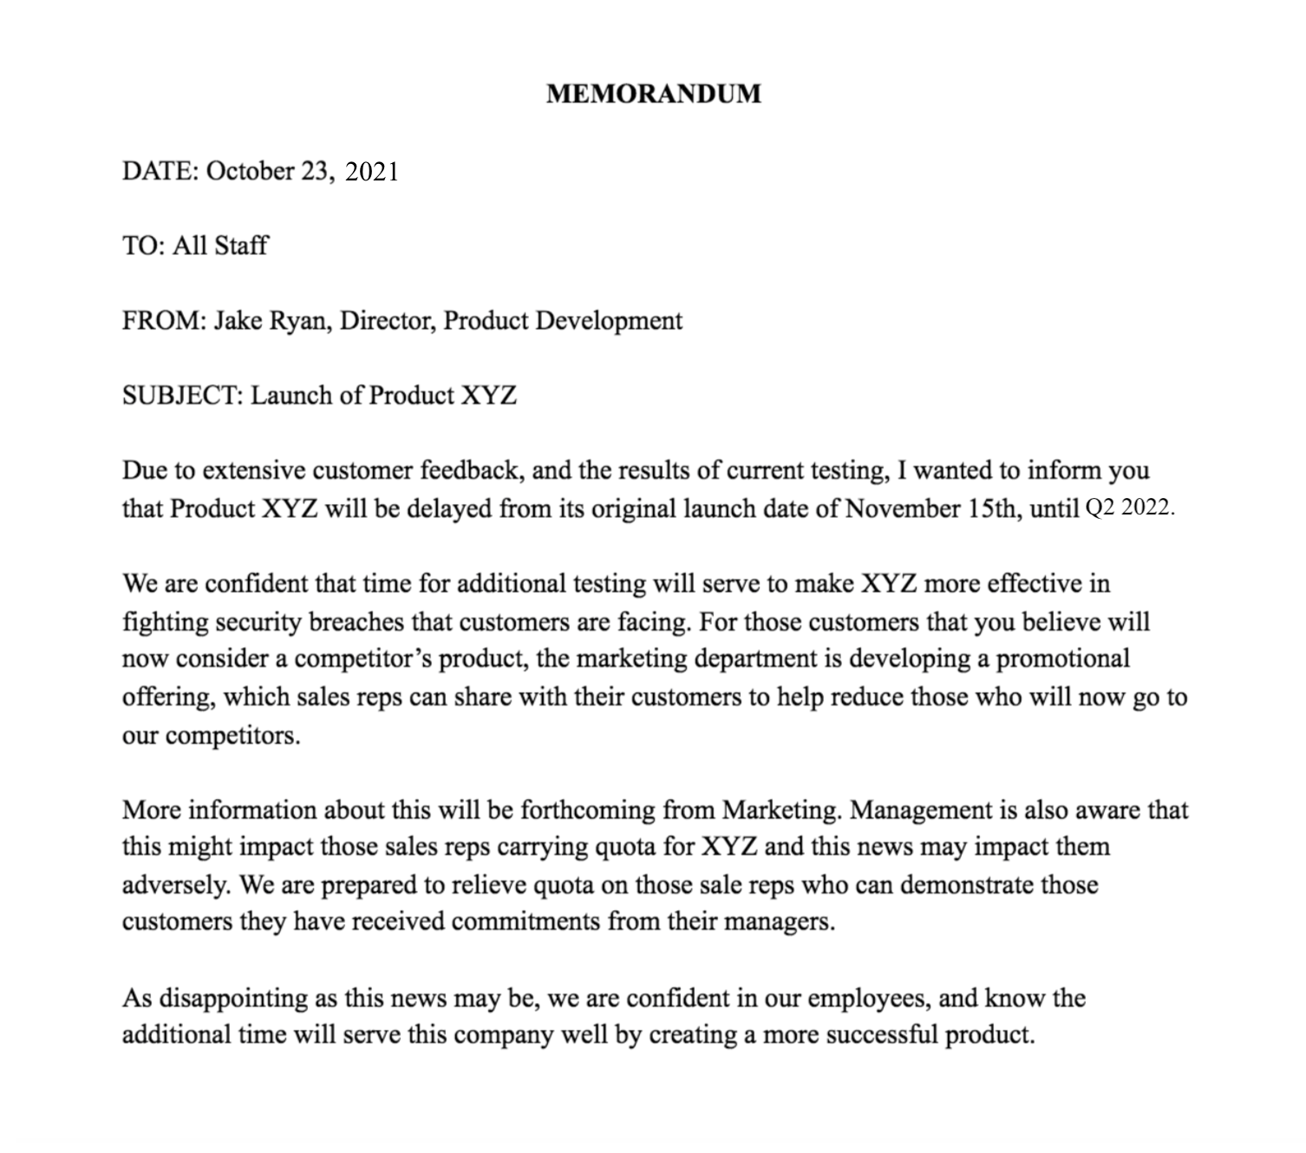
Sample

Slide 12
Assessment Pattern
Students are assessed on the basis of the following parameters:
Hourly Tests - 2
Assignments
Surprise Test
Quiz
Student Engagement
End Semester Exam

Slide 13
References
https://web.uvic.ca/~sdoyle/E302/Notes/Memo%20Writing%20tips.html
https://en.wikipedia.org/wiki/Memorandum
https://www.edco.ie/_fileupload/Writing%20a%20memo.pdf

